Slide 1


2023-081
Improving Cognitive Independence of Dementia Patients Using Machine Learning Enabled Mobile Application
PRESENTED BY | 2023-081
PRESENTED ON | 22/05/2023

Slide 2





Introduction

Slide 3
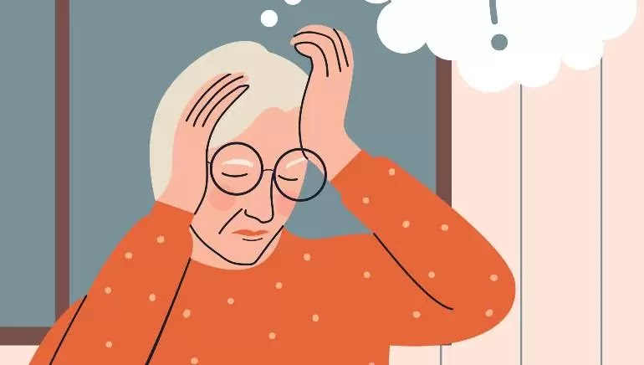
What Is Dementia?
Dementia patients are individuals who have a decline in their cognitive and memory abilities that interferes with their daily life and activities. It is a progressive condition that affects thinking, memory, behavior, and the ability to perform everyday activities.

Slide 4

35.6 Million
Worldwide Population with dementia with an increase of
7.7 Million
New cases every year
By 2030
It is projected to be doubled

Slide 5
Research Problem

Slide 6

Lack of accessibility options in available tools
Affects the quality of life
Affording a caregiver is costly
Lack of resources in available mediums
Caregivers lack the expertise to handle the patient
Caregivers cannot always be available, whenever needed

Slide 7
Research Objectives
To explore and identify the feasible solutions to develop a smart solution to improve the quality of life and independence of Dementia patients
Analyze wandering and predict future movement.
Maintain a digital diary via voice recognition for mental stability.
Feelings detection mechanism to provide musical therapy sessions.
Face recognition system to detect loved ones and relatives.

Slide 8
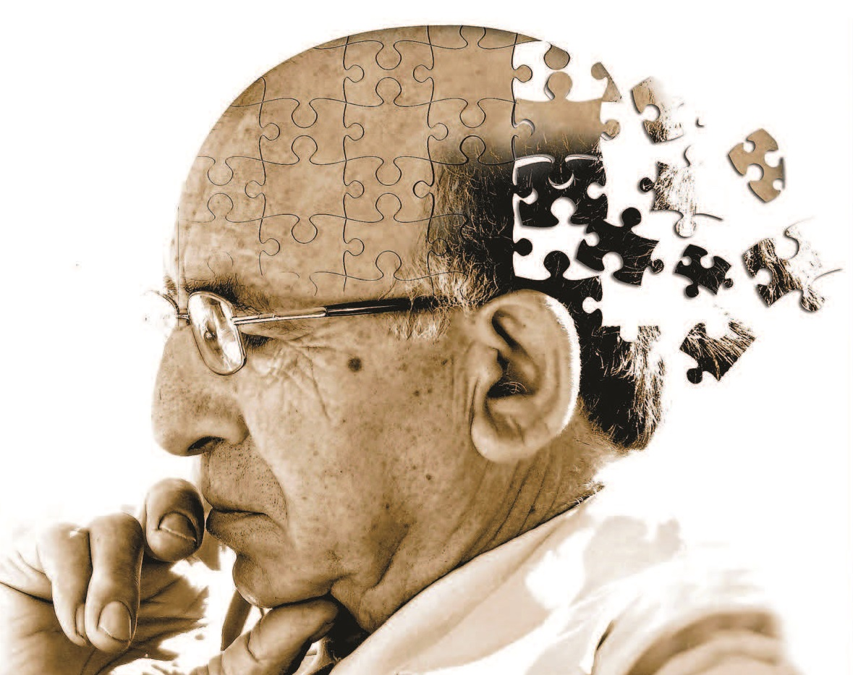
Overall System Diagram

Slide 9
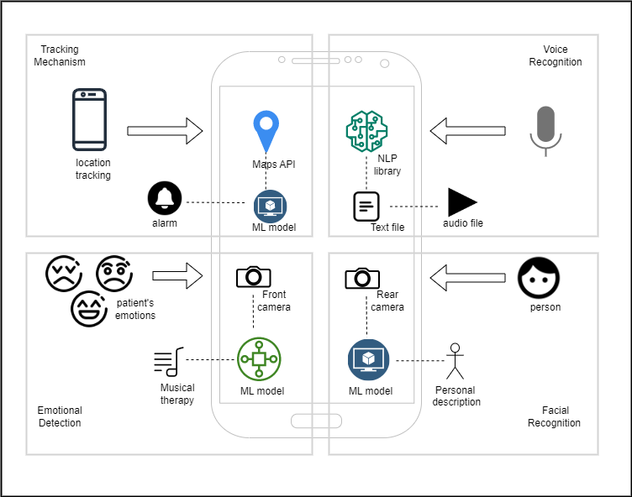

Slide 10
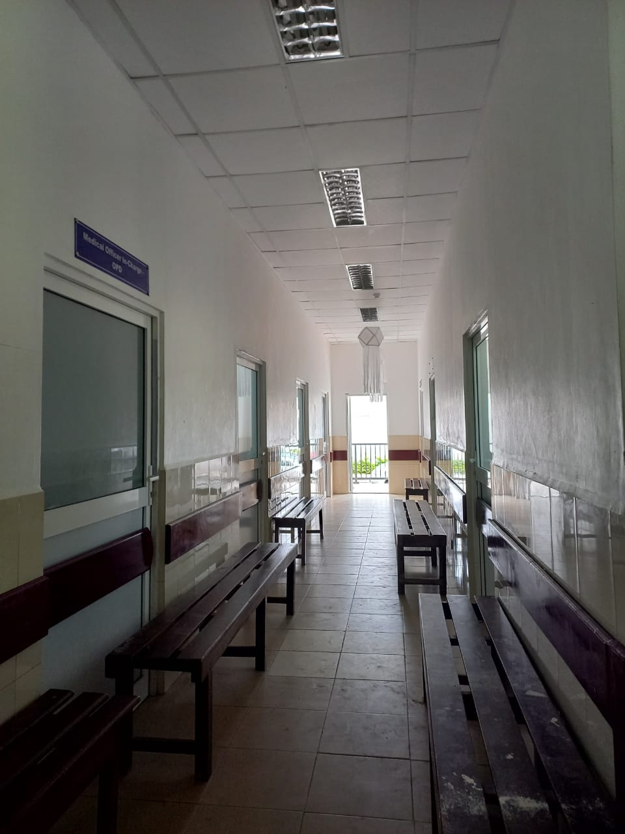
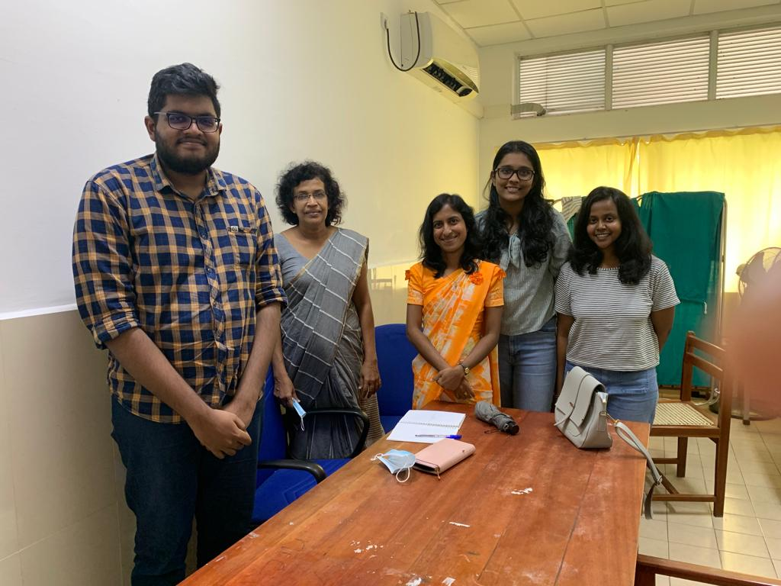
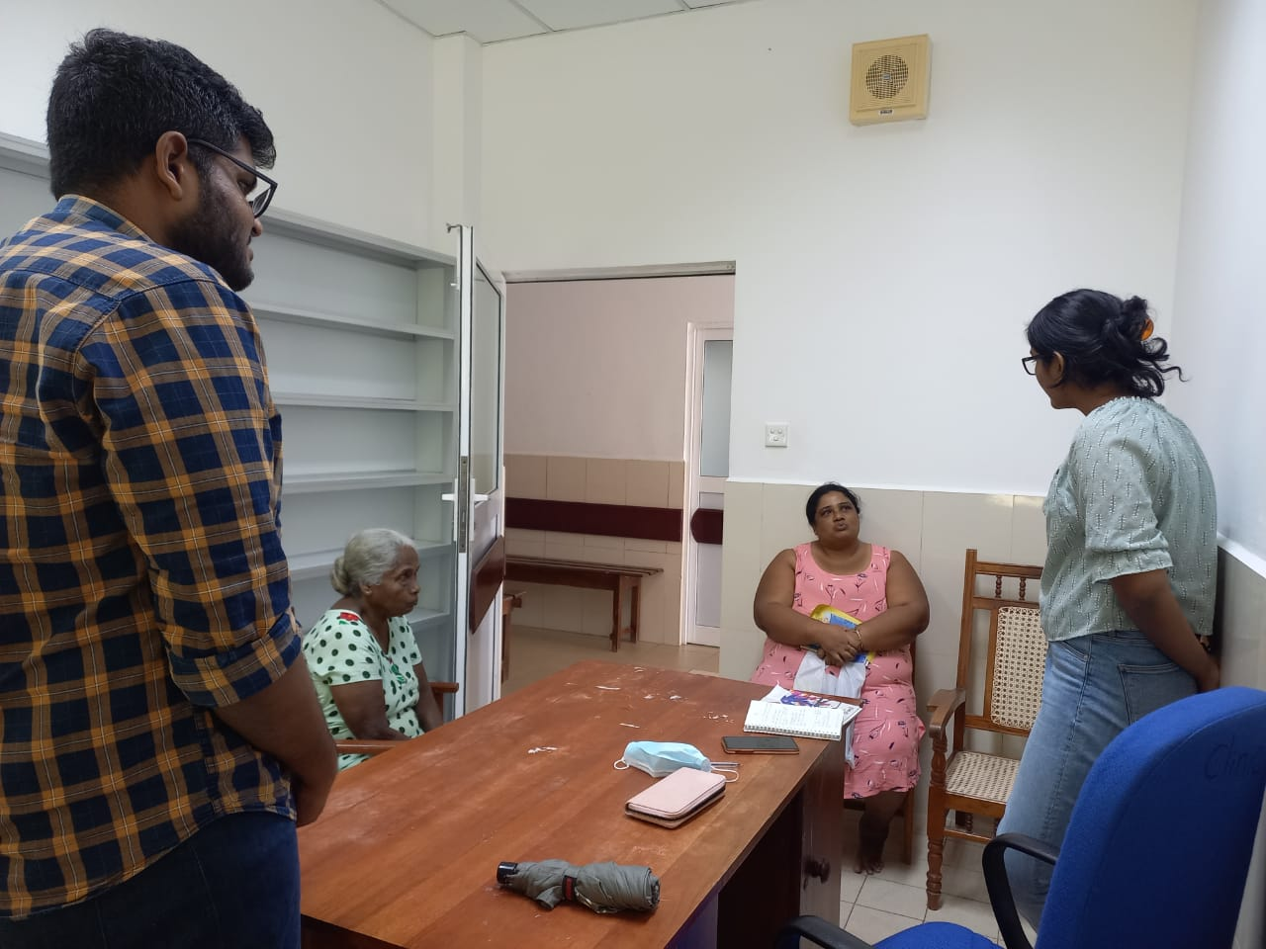
Hospital Visits

Slide 11
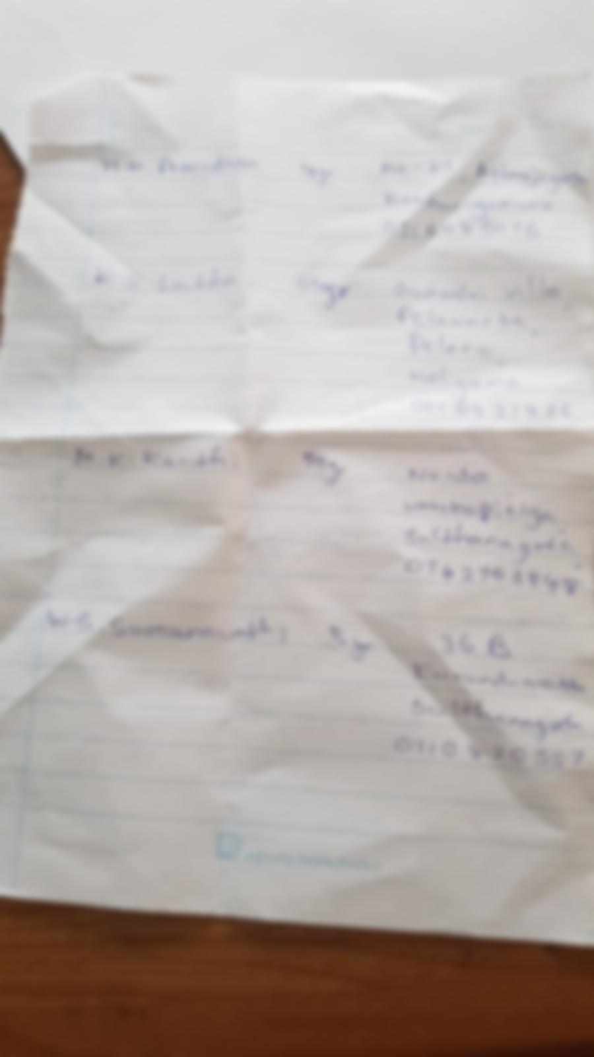
Patient List with their Details
IT20230388 | Kachchakaduwa E.U. | 2023-081

Slide 12
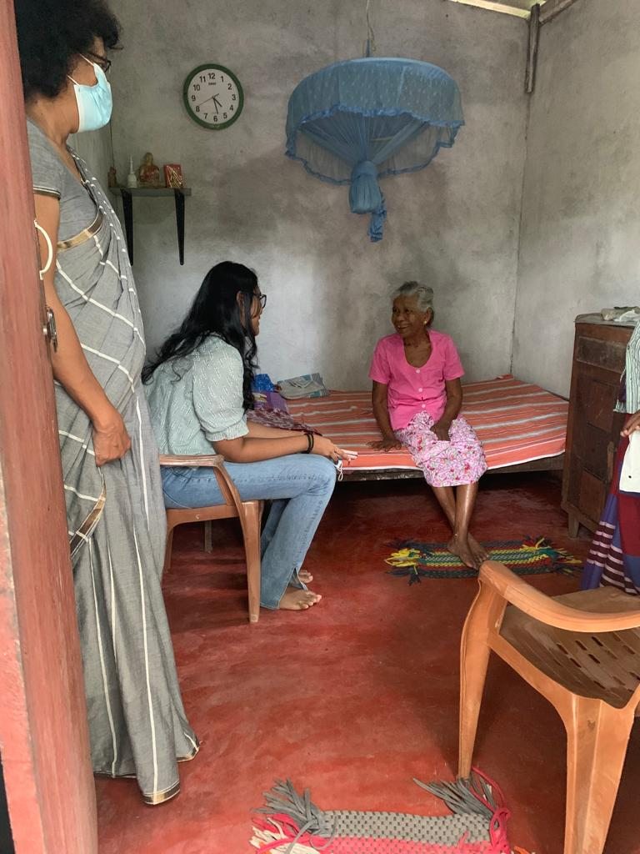
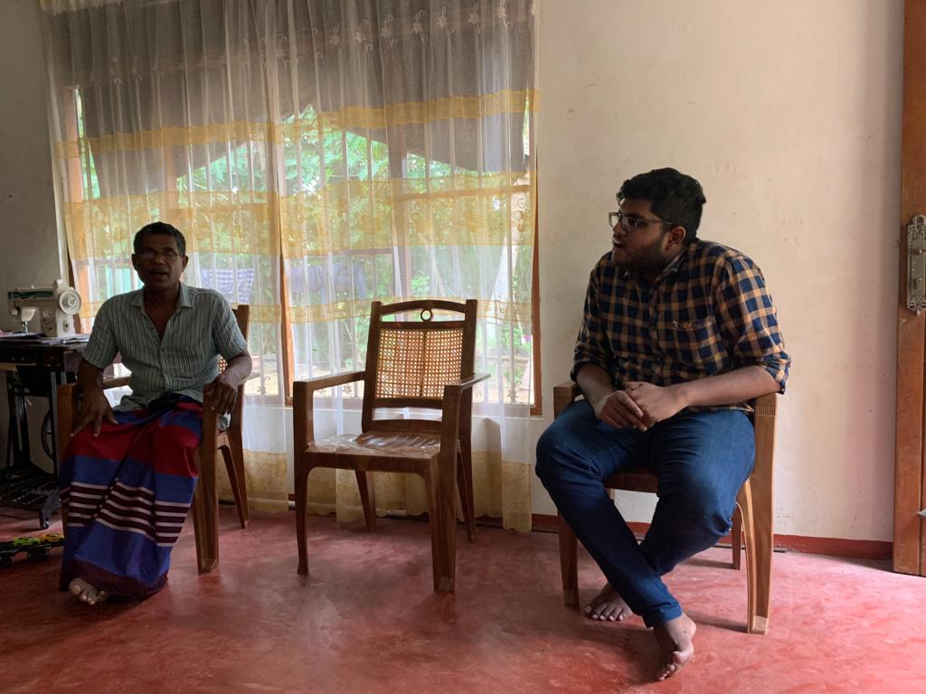
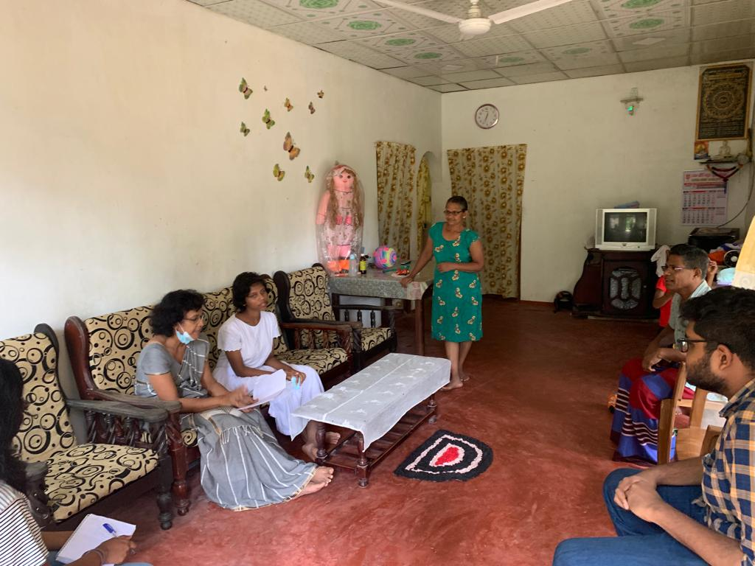
Site Visits

Slide 13
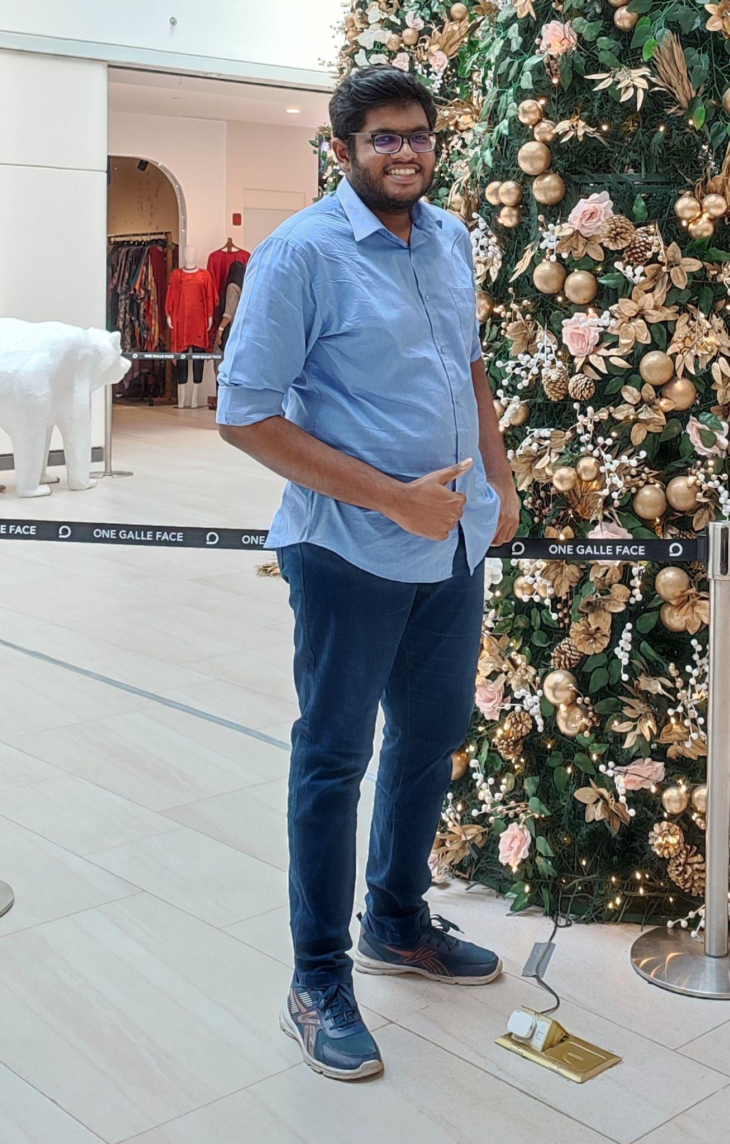
Kachchakaduwa E.U
IT20230388
BSc (Hons) in Information Technology (Specialization in Data Science)
Providing a smart solution for wandering behaviour of dementia patients by inventing a tracking mechanism to track locations while establishing safe zones and analyzing their movement patterns for future predictions.
IT20230388 | Kachchakaduwa E.U. | 2023-081

Slide 14
Research Gap
Research A
Research B
Research C
IoT-Based Wearable Devices for Patients Suffering from Alzheimer Disease [1]
iWander: An Android Application for Dementia Patients [2]
Real-time Location Tracker for Critical Health Patient using Arduino, GPS Neo6m and GSM Sim800L in Health Care [3]
IT20230388 | Kachchakaduwa E.U. | 2023-081

Slide 15
Research Problem
Inability to memorize all the activities and places that visit
Caregivers cannot prioritize their supervision on patinet all the time
50% of the Dementia patients dies and get immobilized due to wandering
Inability to spend money on extra equipment due to moderate and poor economic level
Existing tools lacks accuracy, efficiency and simplicity
No ways to analyze patients history and predict future movements
IT20230388 | Kachchakaduwa E.U. | 2023-081

Slide 16
Inventing a mechanism to constantly track real-time locations of patients and maintain communication with caregiver.
Research Objectives
Create a system to establishing safe zones with customizable options while giving alerts to the caregivers in emergencies.
Providing a smart solution for wandering behaviour of dementia patients by inventing a tracking mechanism to track locations while establishing safe zones and analyzing their movement patterns for future predictions
Build a predictive model to analyze patient’s historic records and predict future movements.
IT20230388 | Kachchakaduwa E.U. | 2023-081

Slide 17
Methodology
IT20230388 | Kachchakaduwa E.U. | 2023-081

Slide 18
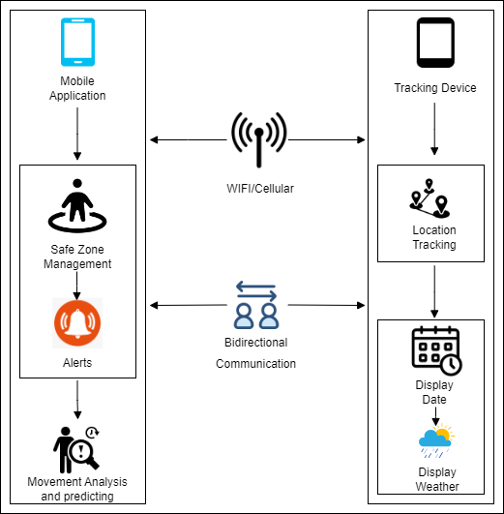
System Diagram
IT20230388 | Kachchakaduwa E.U. | 2023-081

Slide 19






Tools and Technologies
React Native
GitLab
Firebase
Python
MongoDB
Power BI
IT20230388 | Kachchakaduwa E.U. | 2023-081

Slide 20
Techniques and Algorithms
Geofencing
A method of defining virtual barriers on a real geographical location [4]. Can use to define safe zones and trigger alerts when patients enter or exit the defined areas.
Artificial Neural Network (ANN) a neural network used in location tracking [5]
Random Forest Algorithms and Decision Tree Algorithms provide predictions with high accuracies by combining multiple classifiers for problem solving [6]
Artificial Neural Network (ANN)
IT20230388 | Kachchakaduwa E.U. | 2023-081

Slide 21
Evidences for the Completion
IT20230388 | Kachchakaduwa E.U. | 2023-081

Slide 22

High Fidelity Prototype
IT20230388 | Kachchakaduwa E.U. |TMP-23-081

Slide 23
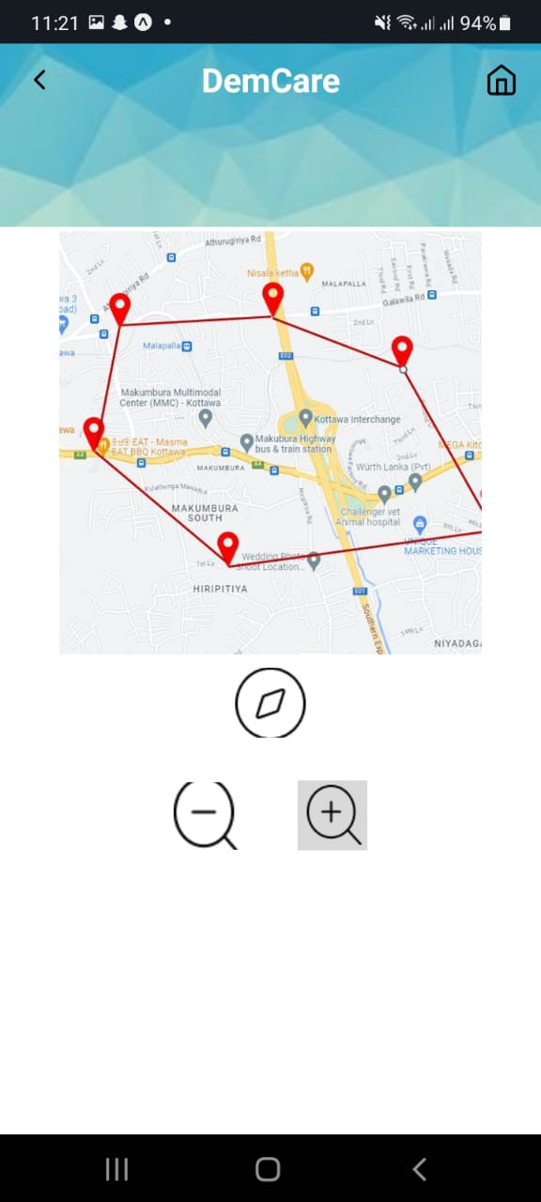
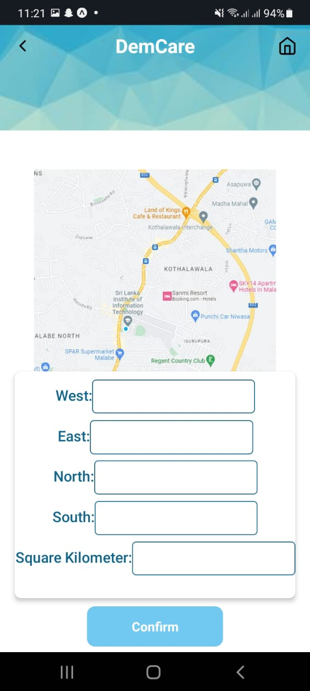
Mobile application UI
Current location
Define safe zones
IT20230388 | Kachchakaduwa E.U. |TMP-23-081

Slide 24
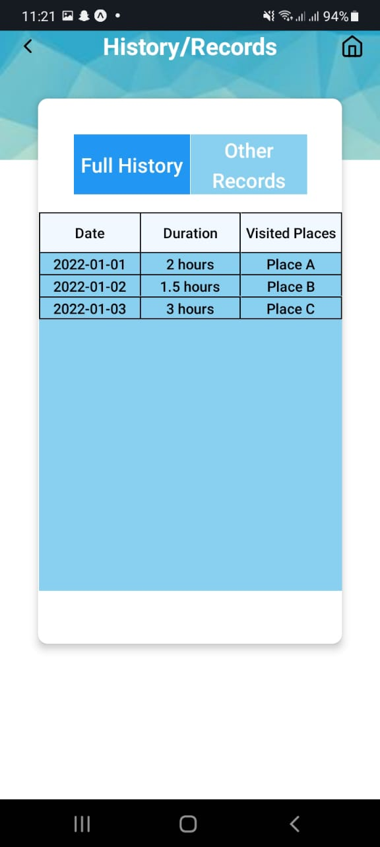
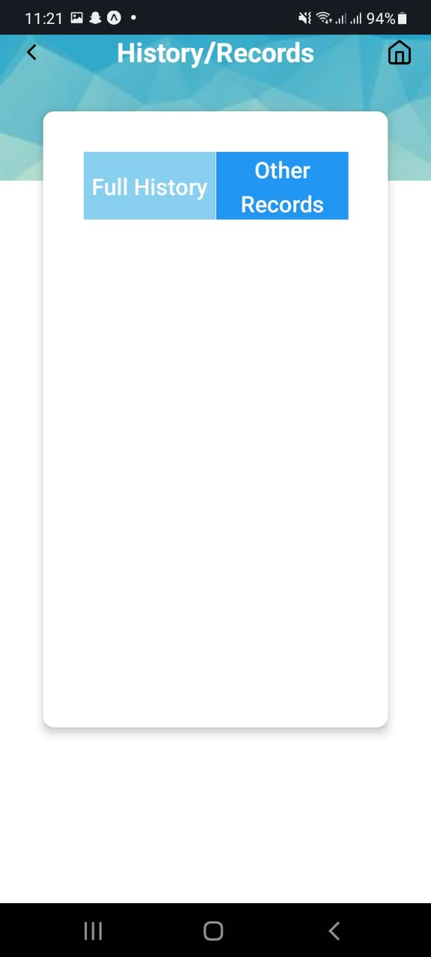
Mobile application UI
History
Records
IT20230388 | Kachchakaduwa E.U. |TMP-23-081

Slide 25
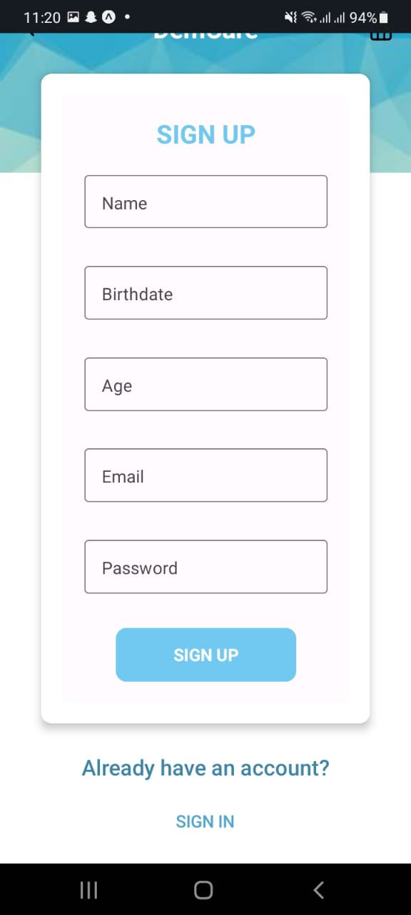
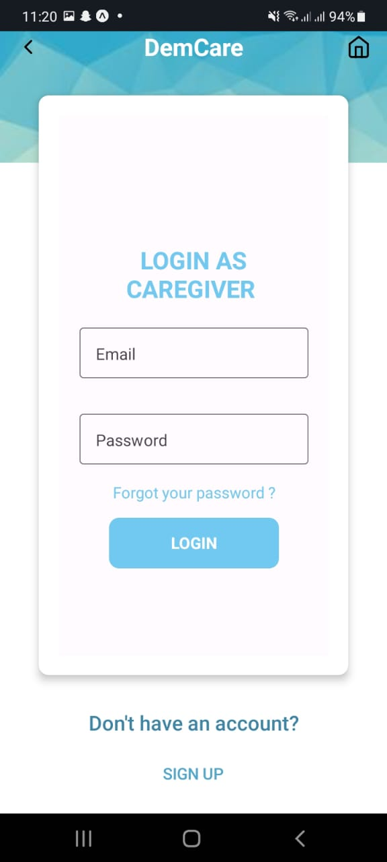
Mobile application UI
Caregiver login
Caregiver registration
IT20230388 | Kachchakaduwa E.U. |TMP-23-081

Slide 26
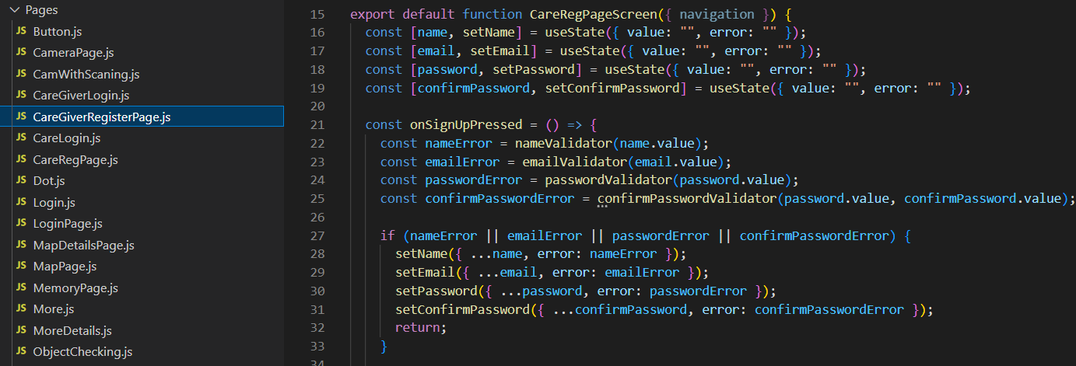
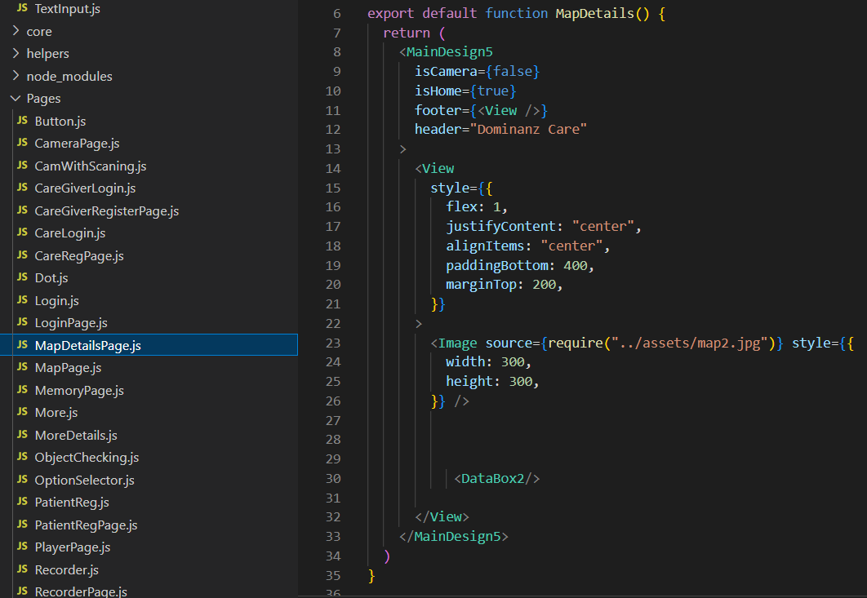
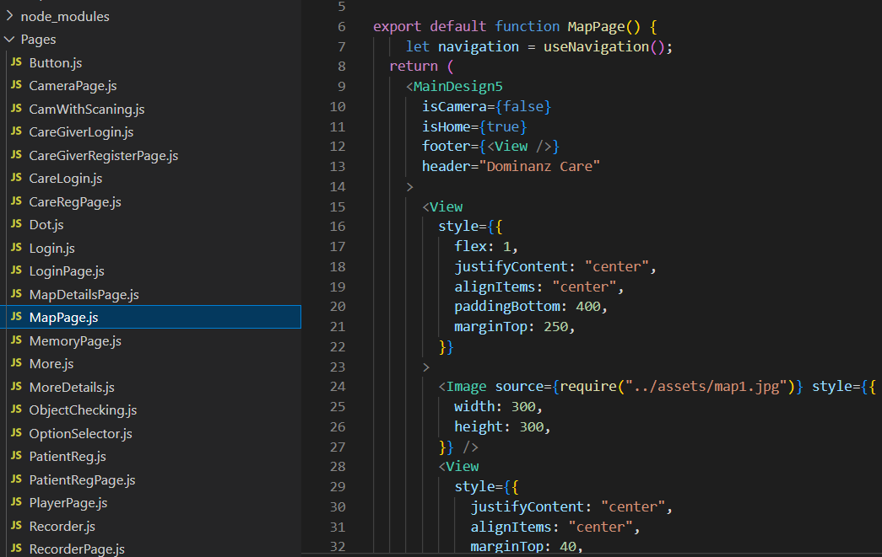
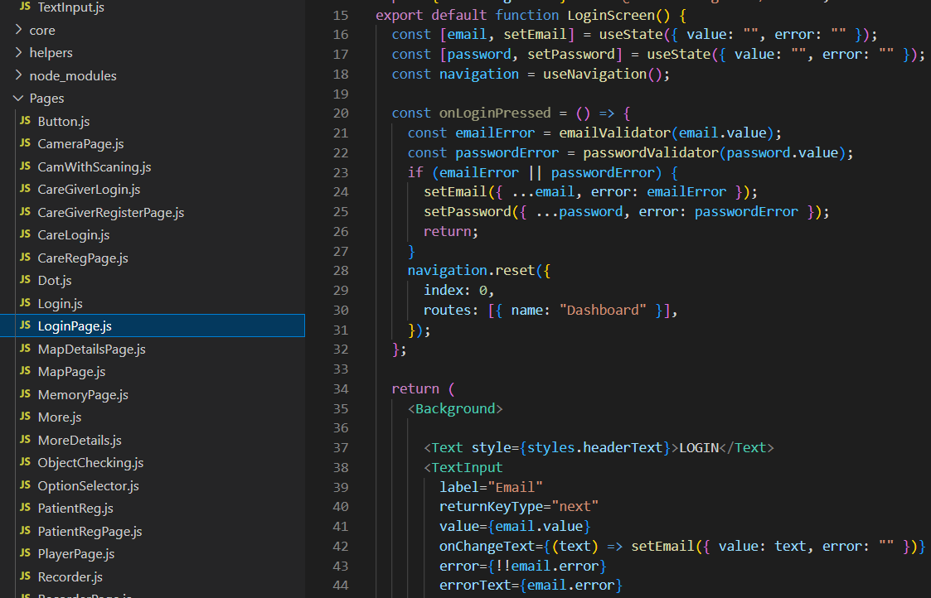
Code Snippets
IT20230388 | Kachchakaduwa E.U. | 2023-081

Slide 27
Tasks to be completed
Train the ML model and improve the accuracy.
Real-time location tracking and safe zones defining.
Integrate and test the whole system together
Commercialize the application
IT20230388 | Kachchakaduwa E.U. | 2023-081

Slide 28
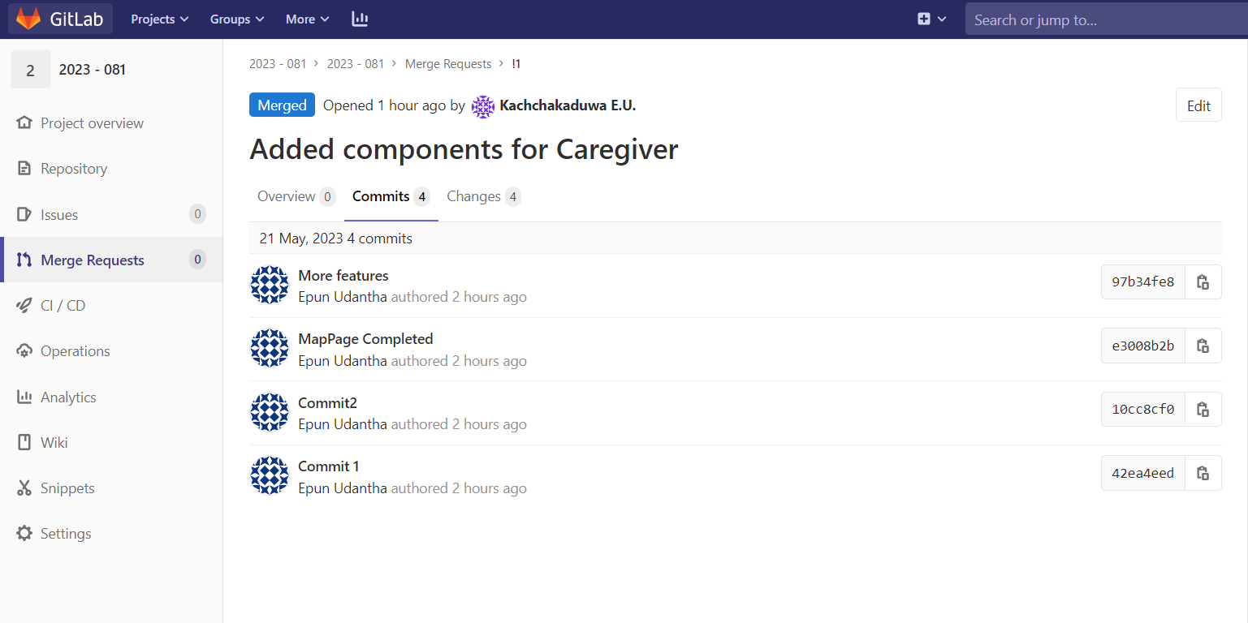
Gitlab Repository
IT20230388 | Kachchakaduwa E.U. | 2023-081

Slide 29
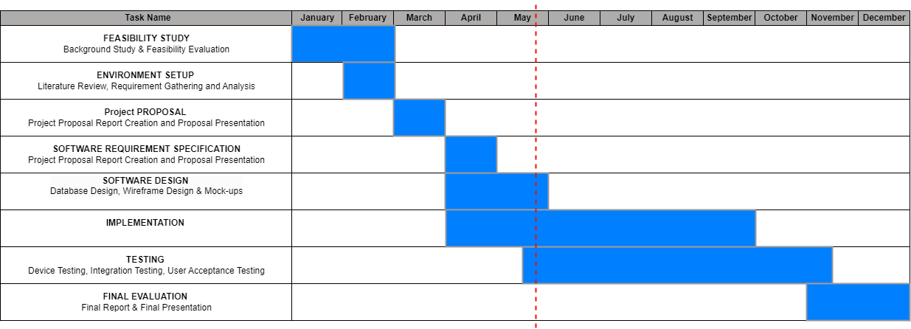
Gantt Chart
IT20230388 | Kachchakaduwa E.U. | 2023-081

Slide 30
Work Breakdown Structure
Providing a smart solution for wandering behaviour of dementia patients by inventing a tracking mechanism to track locations while establishing safe zones and analyzing their movement patterns for future predictions
Feasibility Study
Requirement Analysis
Design
Implementation
Testing
Documentation
Identifying the problem
Gather Requirements
System Design
Implement a real-time location tracking system
Unit Testing
Project Charter
Design a Solution
Analize Requirements
Interface Design
Implement a safe zones monitoring system
Integration Testing
Project Proposal
Literature Review
Well Optimized
Implement a future movements predictive model
User Acceptance Testing
Research Paper
System Testing
Final Report
IT20230388 | Kachchakaduwa E.U. | 2023-081

Slide 31
References
[1] Waleed Salehi, Gaurav Gupta, Surbhi Bhatia, Deepika Koundal, Arwa Mashat, Assaye Belay, "IoT-Based Wearable Devices for Patients Suffering from," 2022.
[2] Frank Sposaro, Justin Danielson, Gary Tyson, "iWander: An Android Application," 2010.
[3] Pratik Kanani, Dr. Mamta Padole, "Real-time Location Tracker for Critical Health," 2020.
[4] Aagy Paulose, Aswathy K S, Nurjahan V A, "Smart Geofencing: An Inventive Mobile Marketing Strategy," p. 2019.
[5][Online]. Available: https://www.ncbi.nlm.nih.gov/pmc/articles/PMC6181345/.
[6] [Online]. Available:https://www.simplilearn.com/tutorials/machine-learning-tutorial/random-forest-algorithm/.
IT20230388 | Kachchakaduwa E.U. | 2023-081

Slide 32
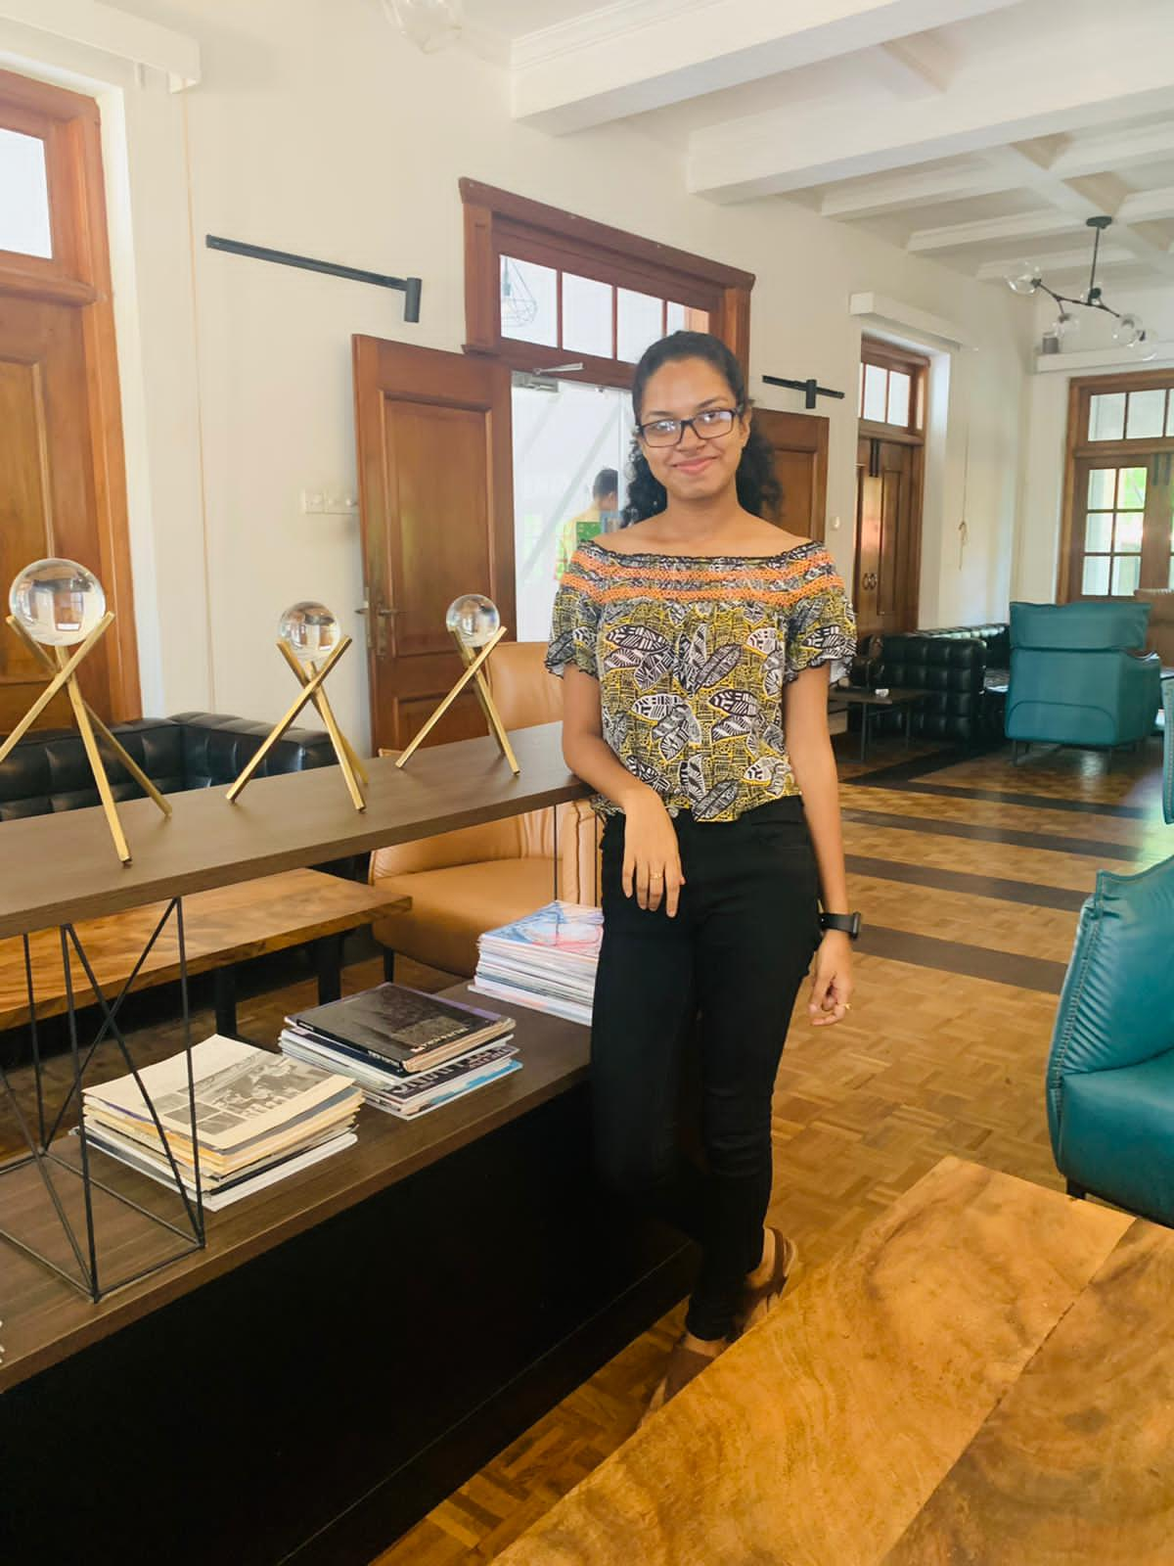
Madhubhashini A.D.P
IT20174576
BSc (Hons) in Information Technology (Specialization in Information Technology)
Design a smart solution that have capability to detect patients loved ones and relatives via face recognition in a way that patient is fully independent.
IT20174576 | Madhubhashini A.D.P. |TMP-23-081

Slide 33
Research Gap
A
B
C
Recognition of familiar people with a mobile cloud architecture for Alzheimer patients [1]
Smart Phone Based Facial and Text Recognition Application (RICO) [2]
Alzheimer assistant: a mobile application using Machine Learning [3]
IT20174576 | Madhubhashini A.D.P. |TMP -23-081

Slide 34
Research Problem
Emotional impact on both the patient and the family members.
Lead to feeling of frustration, fear and anxiety.
Every time can’t get a 3rd party assistant for identify people
Patient may become withdrawn and socially isolated.
Burden on Caregivers.
Not having a proper assistive tool for make their life more independant
IT20174576 | Madhubhashini A.D.P. |TMP - 23-081

Slide 35
Create a model to detect the faces of individuals
Research Objectives
Train a object recognition that can filter Image or video clip of relevant person
Improving the independence by designing a smart and effective solution for the Dementia patients to identify their loved ones by increasing their confidence to remember each member of their family.
Create a text-to speech module to hear the information

Slide 36
Methodology

Slide 37
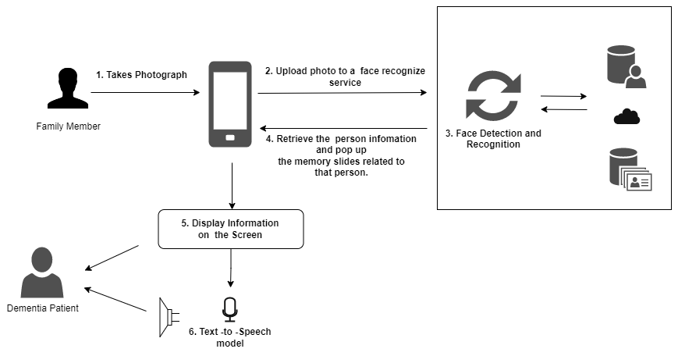
System Overview Diagram

Slide 38
Tools and technologies
Reactnative
GitLab
MongoDB
Firebase
Python

Slide 39
Tools and technologies
Convolutional Neural Network (CNN)
OpenCV
CNN used to detect and match the faces of individuals [4]
CNN cascade operates at multiple resolutions, quickly rejects the background regions in the fast low resolution stages[4]
OpenCV can be used to load and preprocess images before feeding them into the Keras model for further preprocessing.

Slide 40
Evidences for the Completion

Slide 41
High Fidelity Prototype
IT20174576 | Madhubhashini A.D.P. |TMP - 23-081

Slide 42
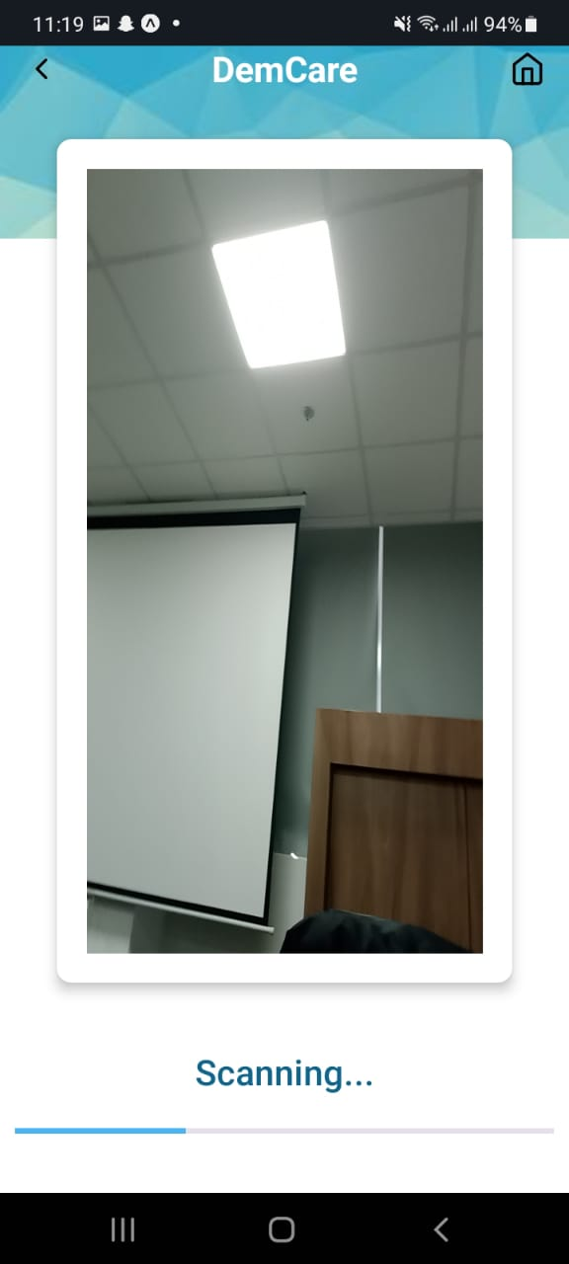
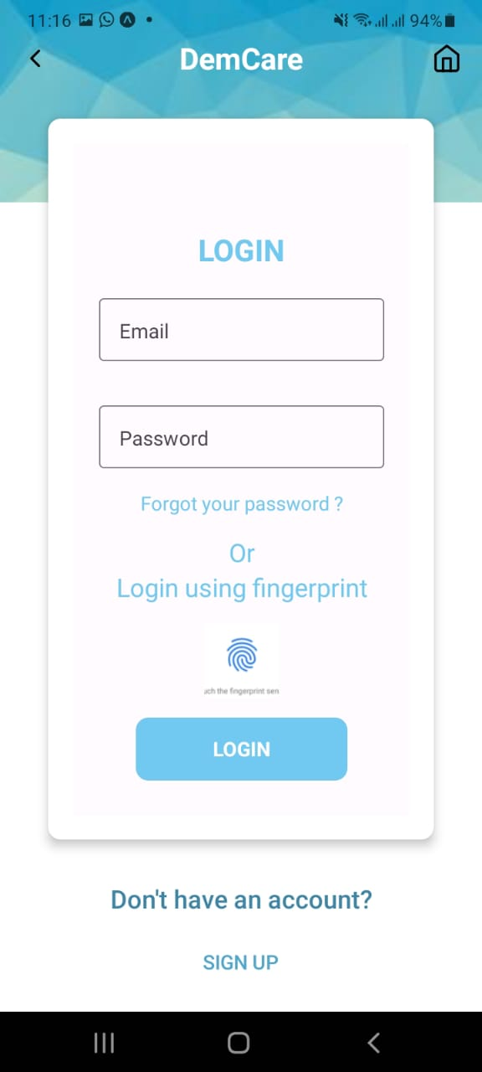
Mobile Application UI
Patient Login
Recognizing the person using the Rear Camera
IT20174576 | Madhubhashini A.D.P. |TMP - 23-081

Slide 43
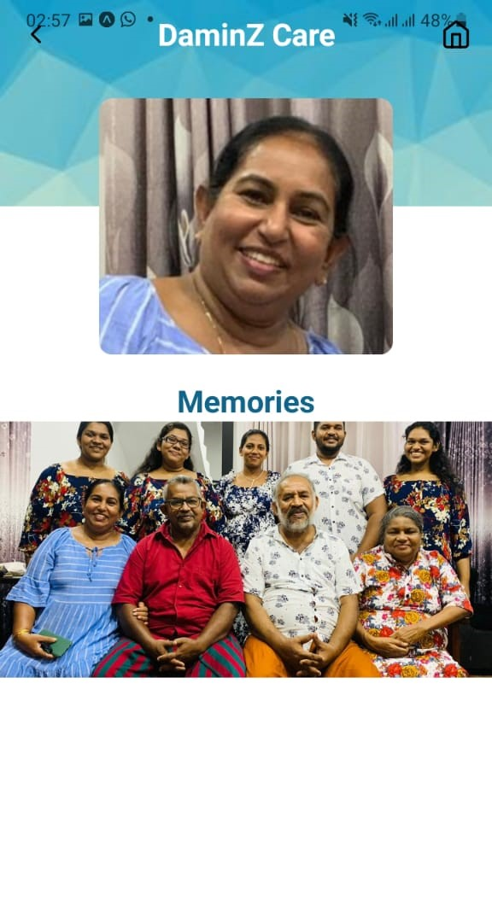
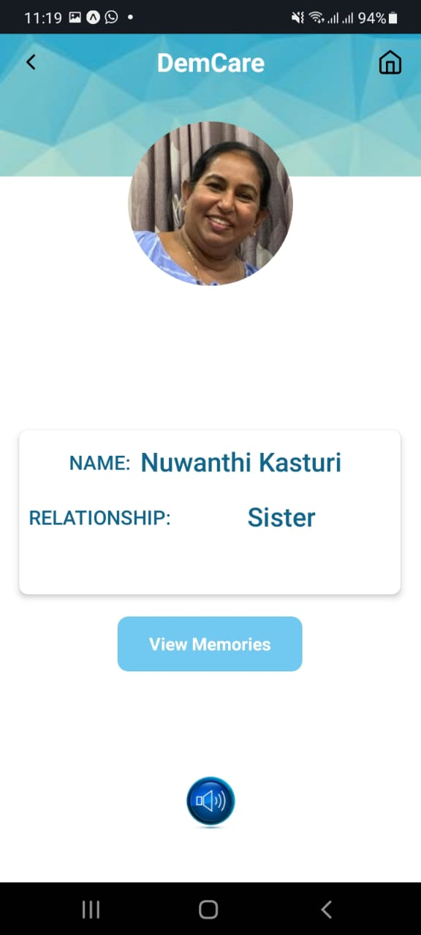
Mobile Application UI
Relationship Status
Memories Page
IT20174576 | Madhubhashini A.D.P. |TMP - 23-081

Slide 44
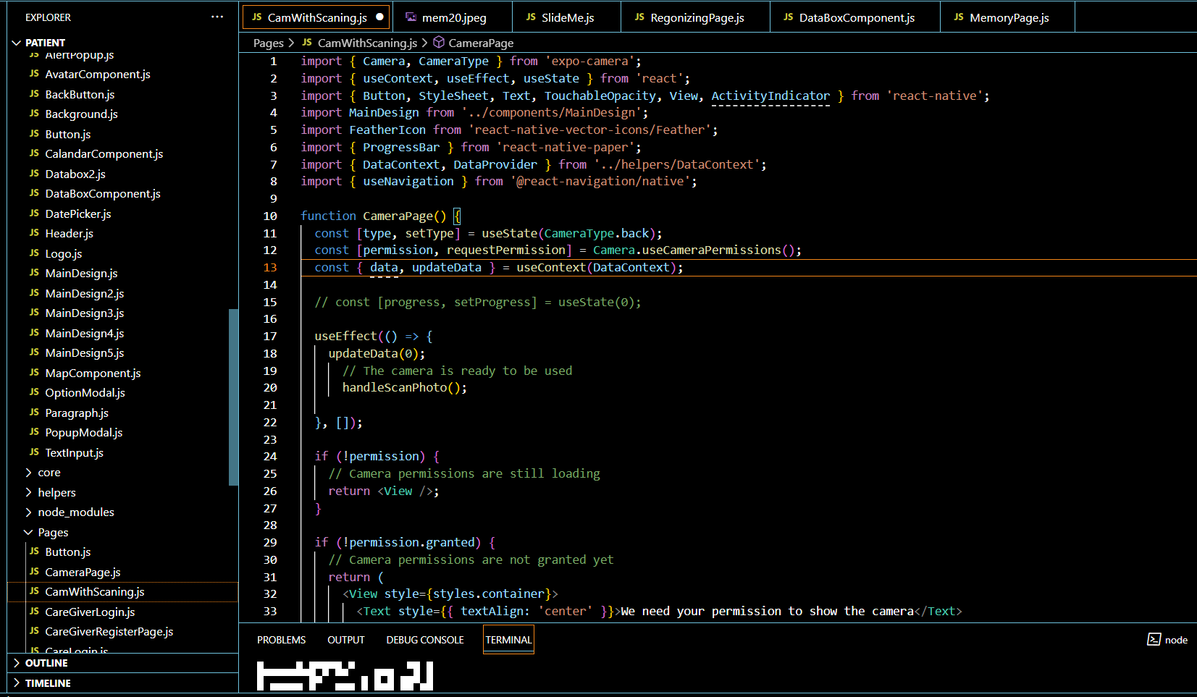
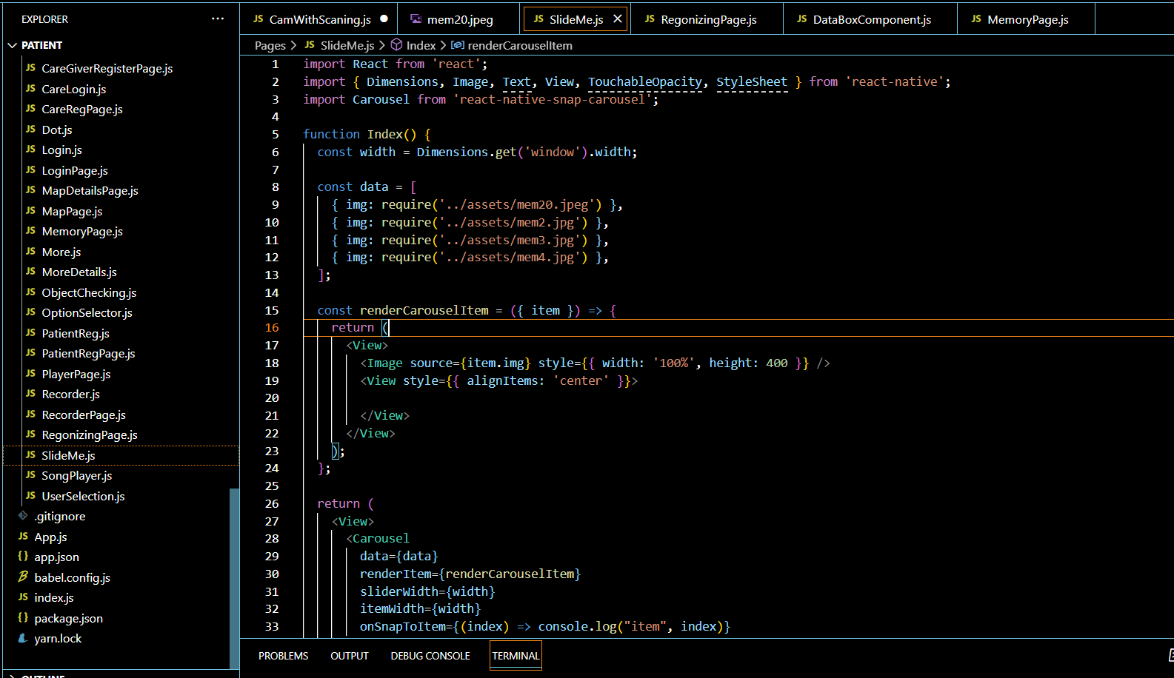
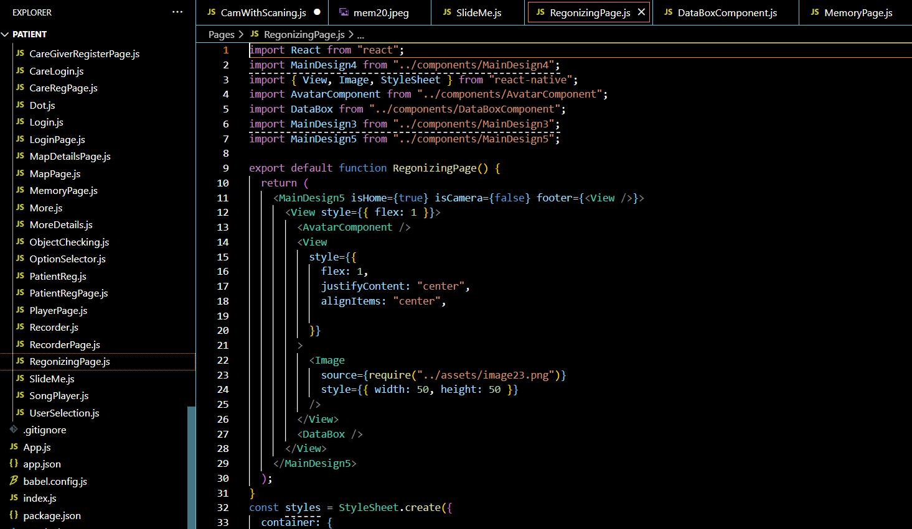
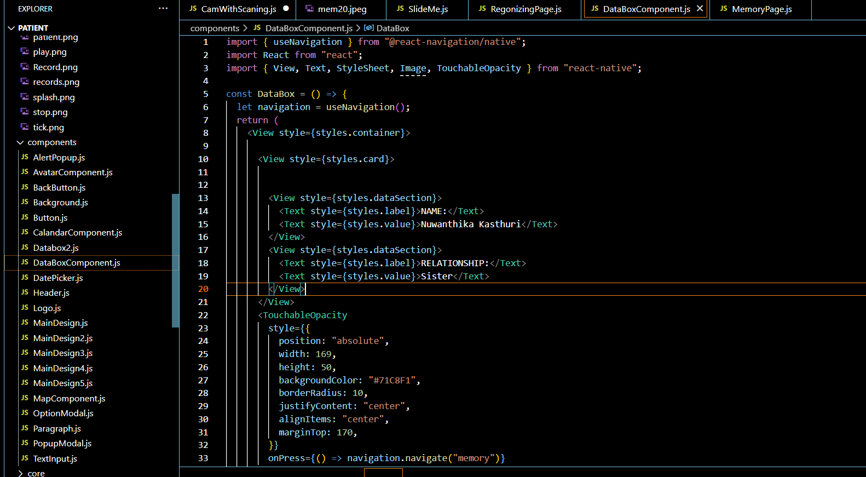
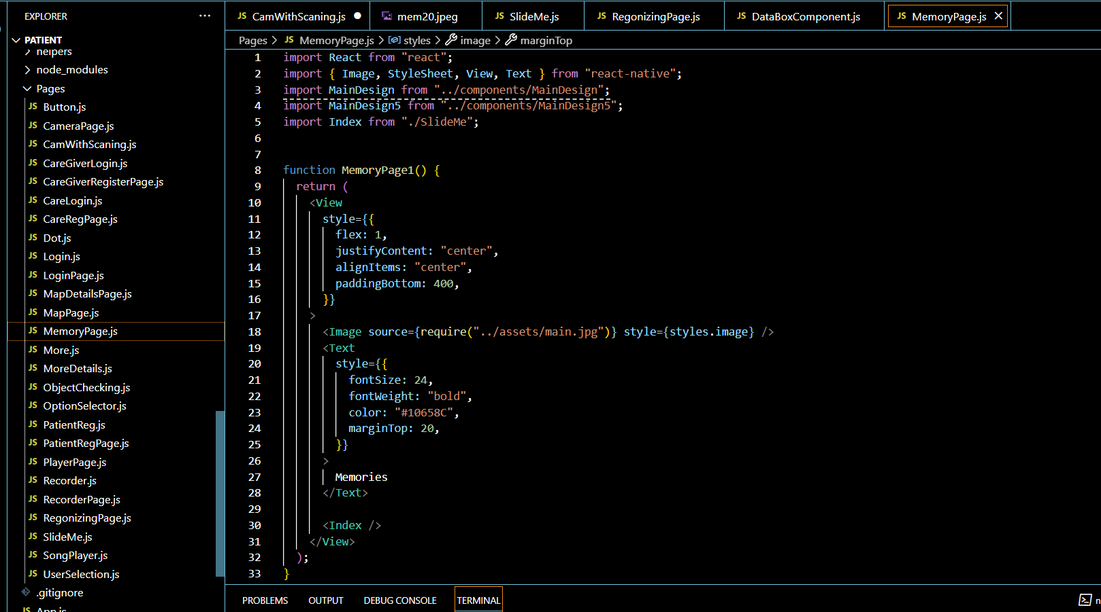
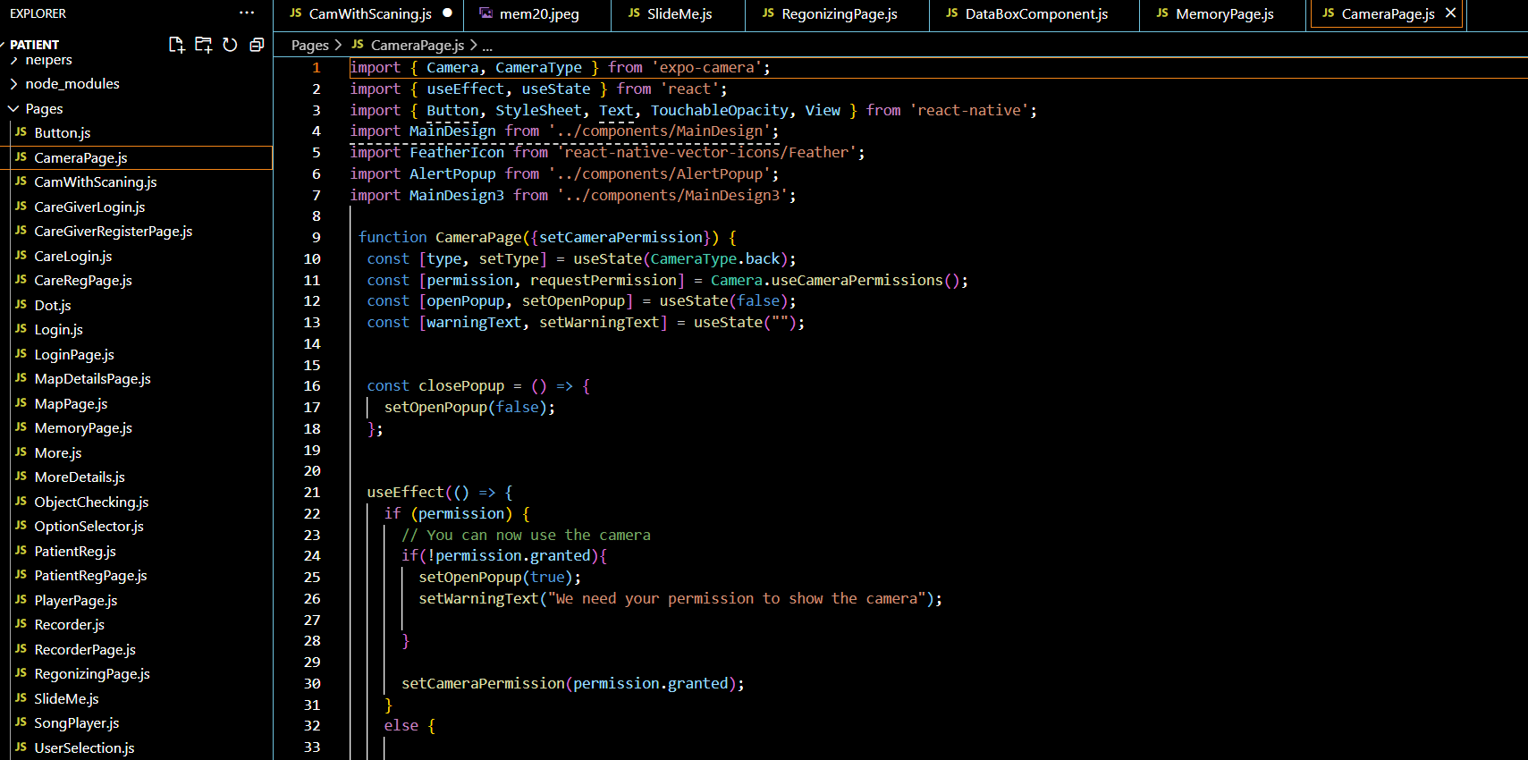
Code Snippets
IT20174576 | Madhubhashini A.D.P. |TMP - 23-081

Slide 45
Tasks to be completed
●Train the ML model and improve the accuracy
● Integrate and test the whole system together
● Import Google text -to-speech API to the application
IT20174576 | Madhubhashini A.D.P. |TMP -23-081

Slide 46
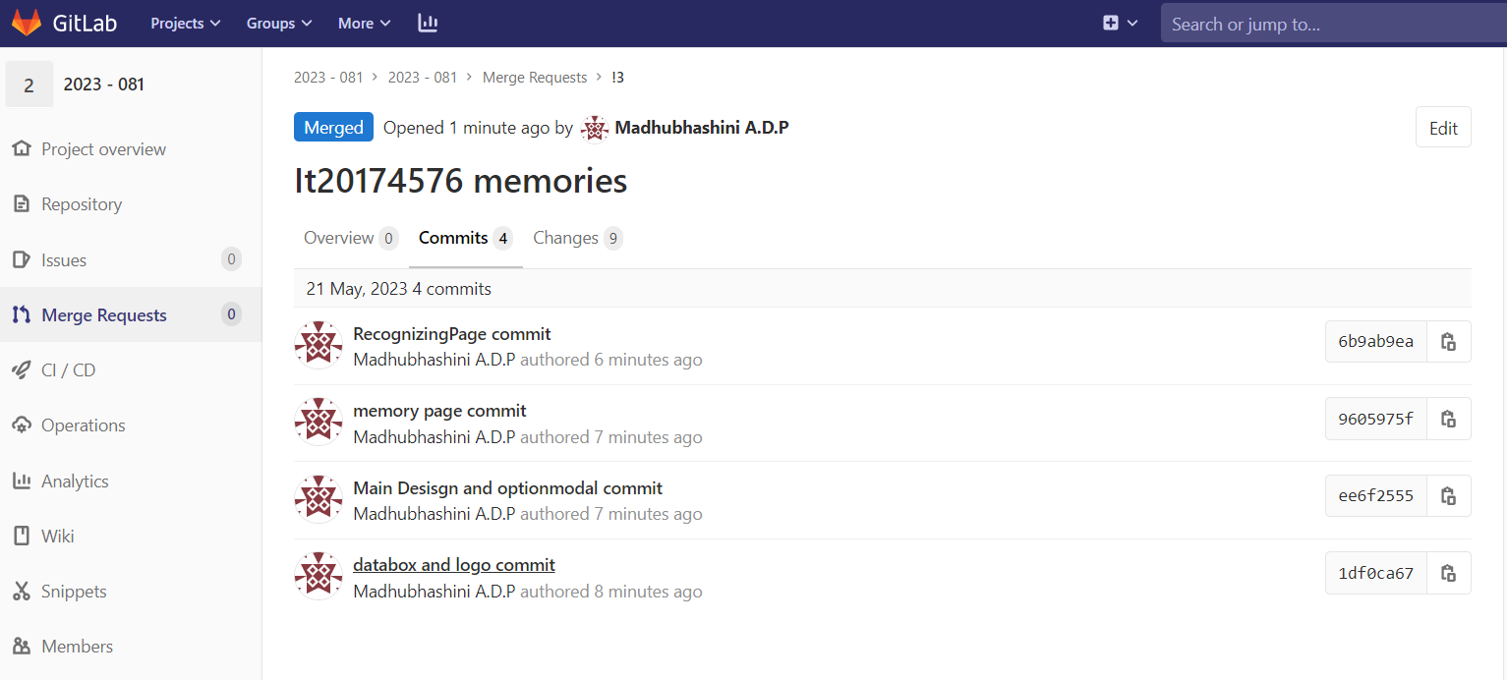
Gitlab Repository
IT20174576 | Madhubhashini A.D.P. |TMP - 23-081

Slide 47
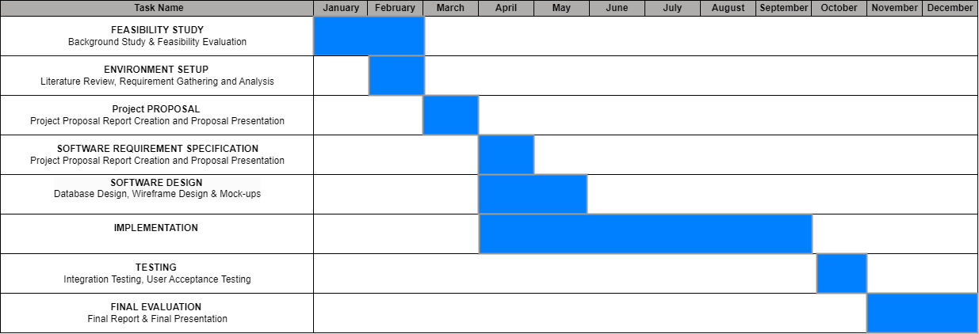
Gantt Chart
IT20174576 | Madhubhashini A.D.P. |TMP23-081

Slide 48
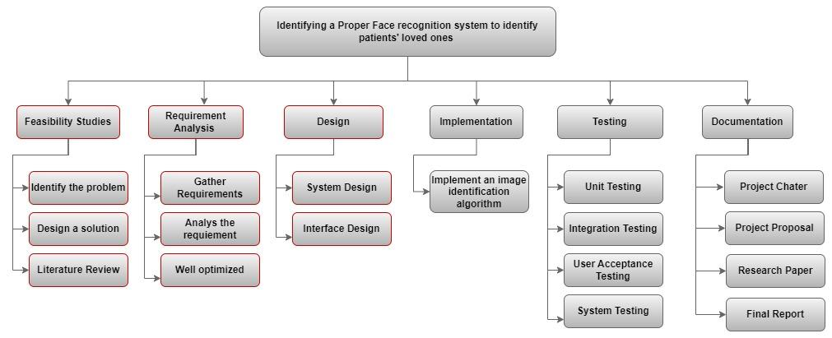
Work Breakdown Chart

Slide 49
References
[15] [1] H. M. Fardoun, A. A. Mashat, and J. Ramirez Castillo, “Recognition of familiar people with a mobile cloud architecture for Alzheimer patients,” Disabil Rehabil, vol. 39, no. 4, pp. 398–402, Feb. 2017, doi: 10.3109/09638288.2015.1025992.
[4 [2] Sadjad University of Technology, Institute of Electrical and Electronics Engineers. Iran Section., and Institute of Electrical and Electronics Engineers, ICEE 2018 : 2018 26th Iranian Conference on Electrical Engineering : Sadjad University of Technology, 8-10 May 2018.
[3] N. Aljojo et al., “Alzheimer assistant: a mobile application using Machine Learning,” Revista Română de Informatică și Automatică, vol. 30, no. 4, pp. 7–26, Dec. 2020, doi: 10.33436/v30i4y202001tant: a mobile application using Machine Learning,” Revista Română de Informatică și Automatică, vol. 30, no. 4, pp. 7–26, Dec. 2020, doi: 10.33436/v30i4y202001
[4] M. M. Kasar, D. Bhattacharyya, and T. H. Kim, “Face recognition using neural network: A review,” International Journal of Security and its Applications, vol. 10, no. 3, pp. 81–100, 2016, doi: 10.14257/ijsia.2016.10.3.08.
[5] Institute of Electrical and Electronics Engineers and PPG Institute of Technology, Proceedings of the 5th International Conference on Communication and Electronics Systems (ICCES 2020) : 10-12, June 2020.

Slide 50
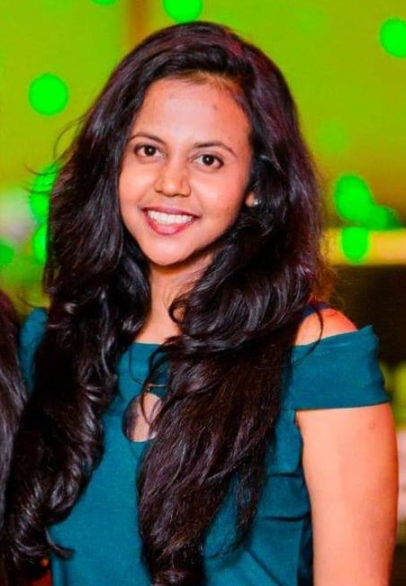
Jayasinghe J.M.S.U.
IT20034740
BSc (Hons) in Information Technology (Specialization in Software Engineering)
Providing a smart solution by using voice recognition and NLP to maintain a digital audio diary by a patient as journalism helps to keep stability of memory
IT20034740 | Jayasinghe J.M.S.U. |2023-081

Slide 51
Research Gap
Personal Journal Keeping and Linguistic Complexity Predict Late-Life Dementia Risk [1]
Modifying the Diary Interview Method to Research the Lives of People With Dementia [2]
AN INDEPENDENT EVALUATION OF ‘DEMENTIA DIARIES’ [3]
IT20034740 | Jayasinghe J.M.S.U. |2023-081

Slide 52
Research Problem
Forgetting daily tasks
Social isolation
Difficulties in communication
Frustrations and stressful behavioral patterns
Lack of literacy and poor vocabulary
Depression and anxiety
IT20034740 | Jayasinghe J.M.S.U. |2023-081

Slide 53
Speech recognition and voice detection
Research Objectives
Converting speech to text using NLP algorithms to ease maintaining diaries
Improving the cognitive independence and wellbeing of dementia patients by motivating them to maintain a digital audio diary.
Prediction of summarized speeches
IT20034740 | Jayasinghe J.M.S.U. |2023-081

Slide 54
Methodology
IT20034740 | Jayasinghe J.M.S.U. |2023-081

Slide 55
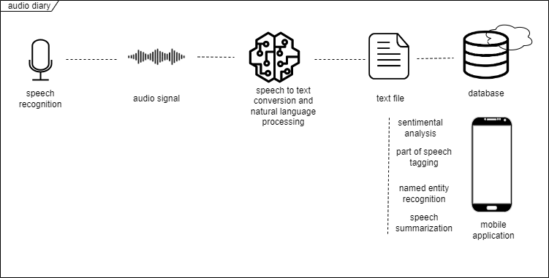
System Overview Diagram
IT20034740 | Jayasinghe J.M.S.U. |2023-081

Slide 56
Tools and technologies
Reactnative
GitLab
MongoDB
Firebase
Python
IT20034740 | Jayasinghe J.M.S.U. |2023-08181

Slide 57
Techniques and Algorithms
Linear Predictive Coding (LPC)
Pre processing in feature extraction of voice
React native package for speech to text conversion
Google voice to text API
Hidden Markov Model (HMM)
a statistical model used in speech recognition
Artificial Neural Network (ANN) [5]
IT20034740 | Jayasinghe J.M.S.U. |2023-081

Slide 58
Evidences for the Completion
IT20034740 | Jayasinghe J.M.S.U. |2023-081

Slide 59
High Fidelity Prototype
IT20034740 | Jayasinghe J.M.S.U. |2023-081

Slide 60
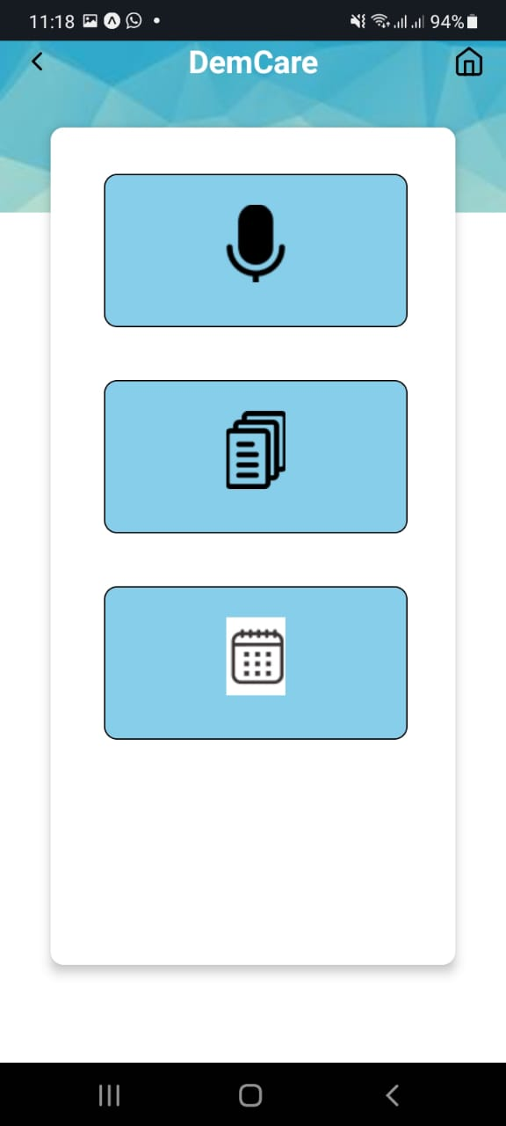
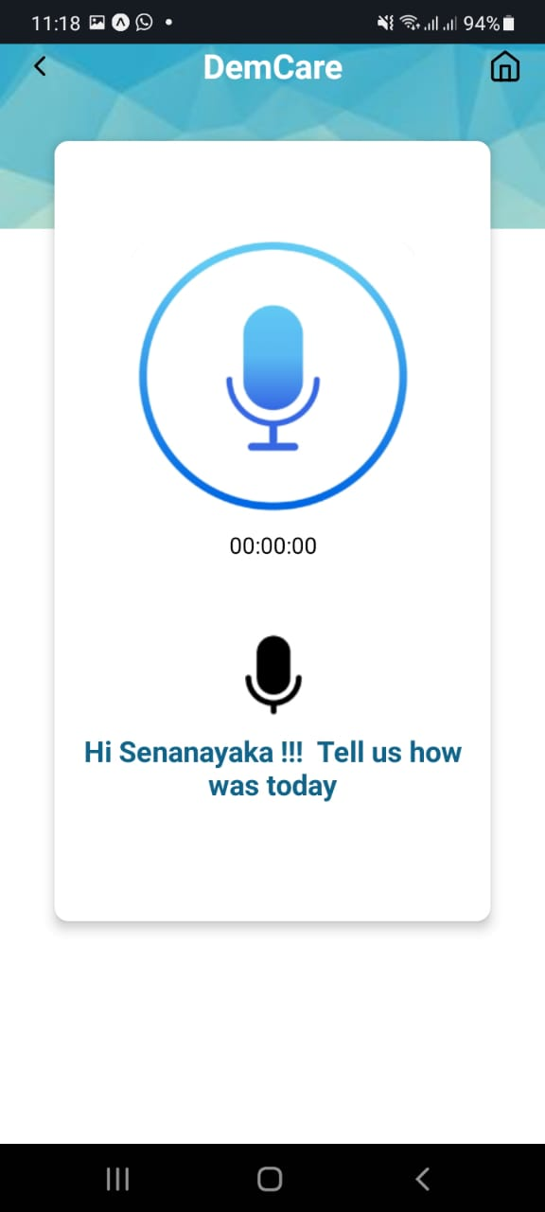
Mobile Application UI
Audio diary page
Voice recorder
IT20034740 | Jayasinghe J.M.S.U. |2023-081

Slide 61
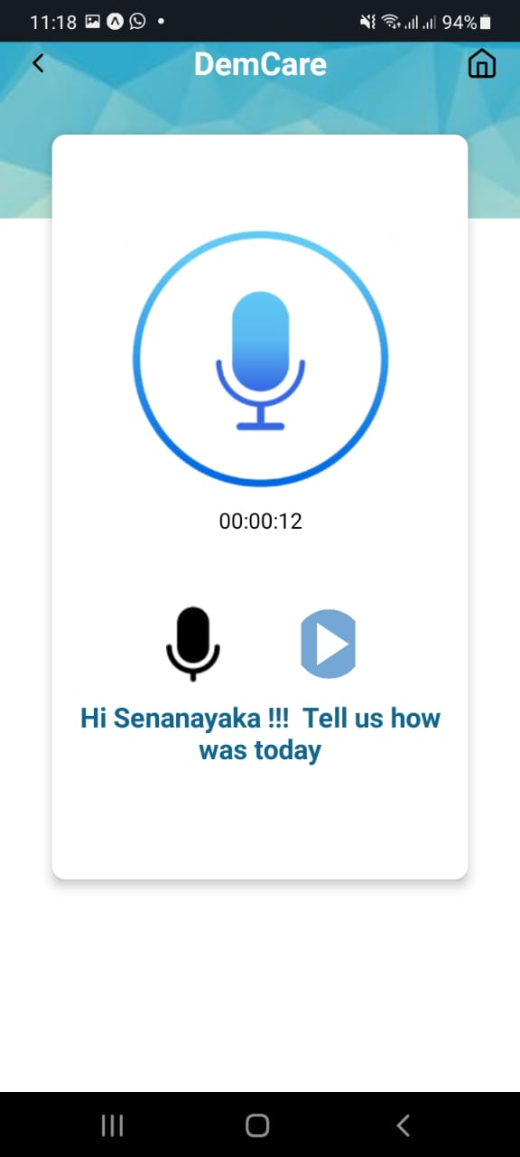
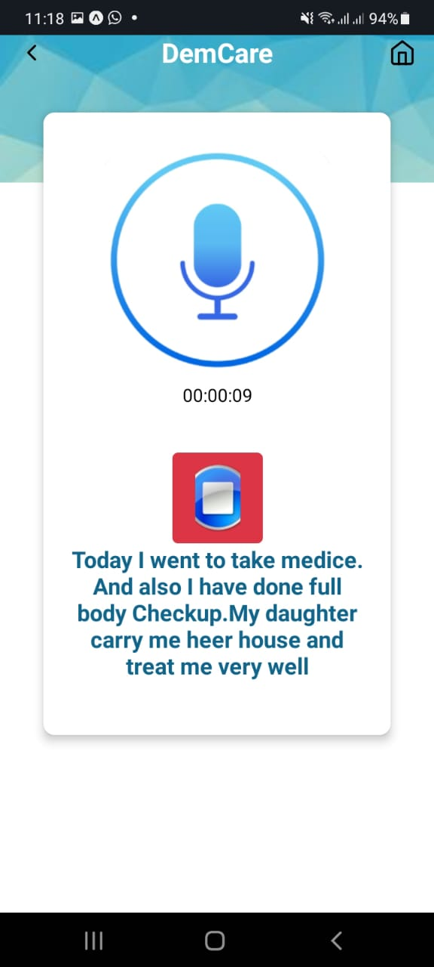
Mobile Application UI
Play voice recording
Text conversion
IT20034740 | Jayasinghe J.M.S.U. |2023-081

Slide 62
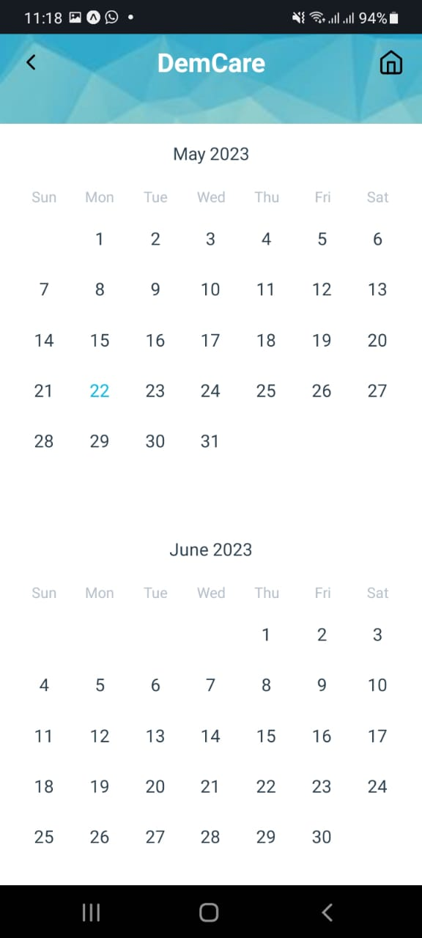
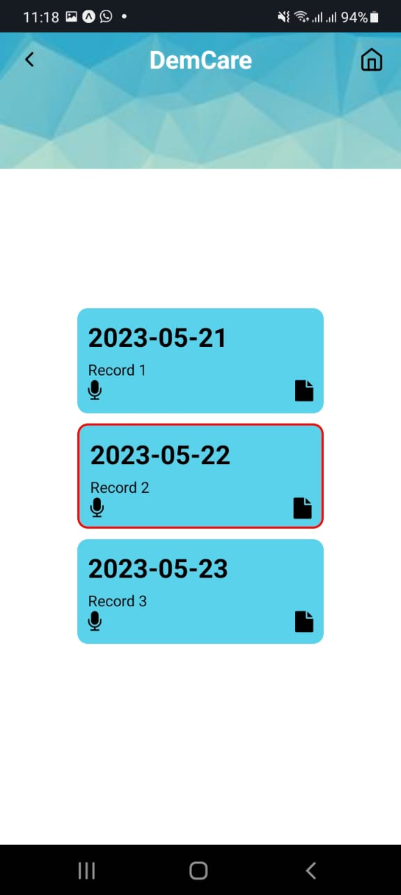
Mobile Application UI
Calendar page
Diary records
IT20034740 | Jayasinghe J.M.S.U. |2023-081

Slide 63
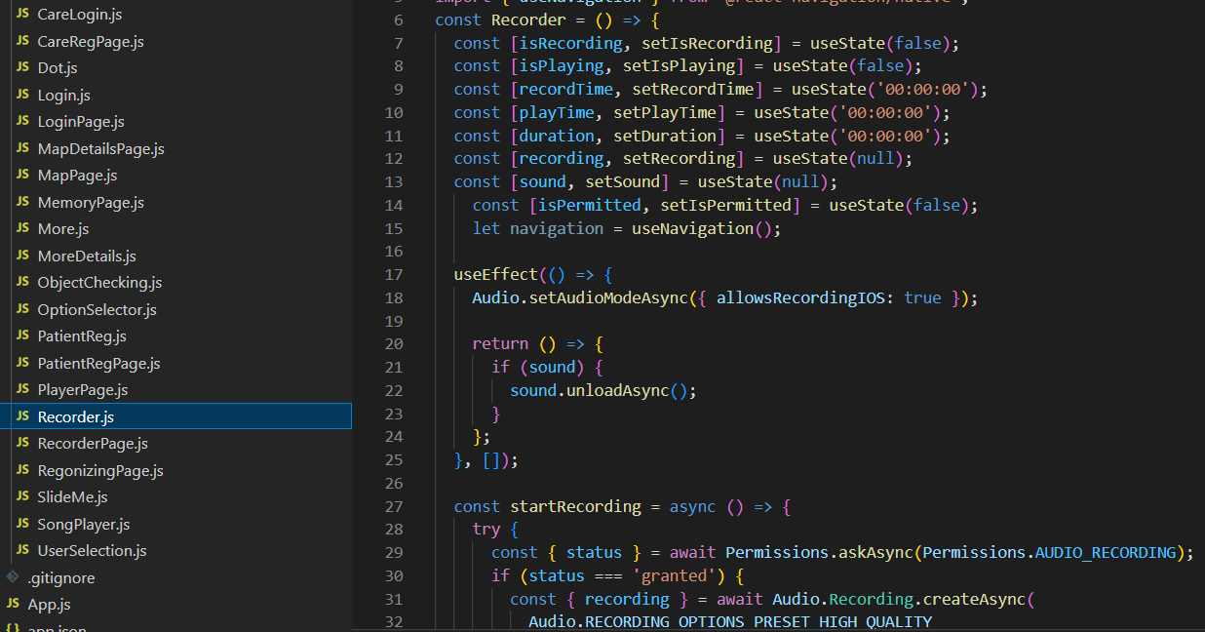
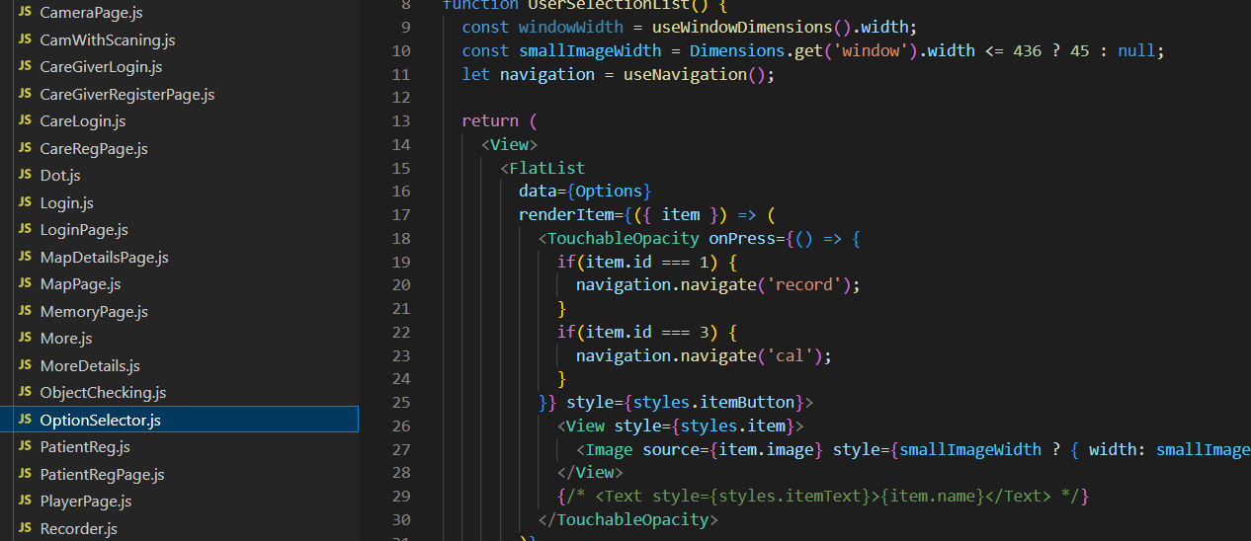
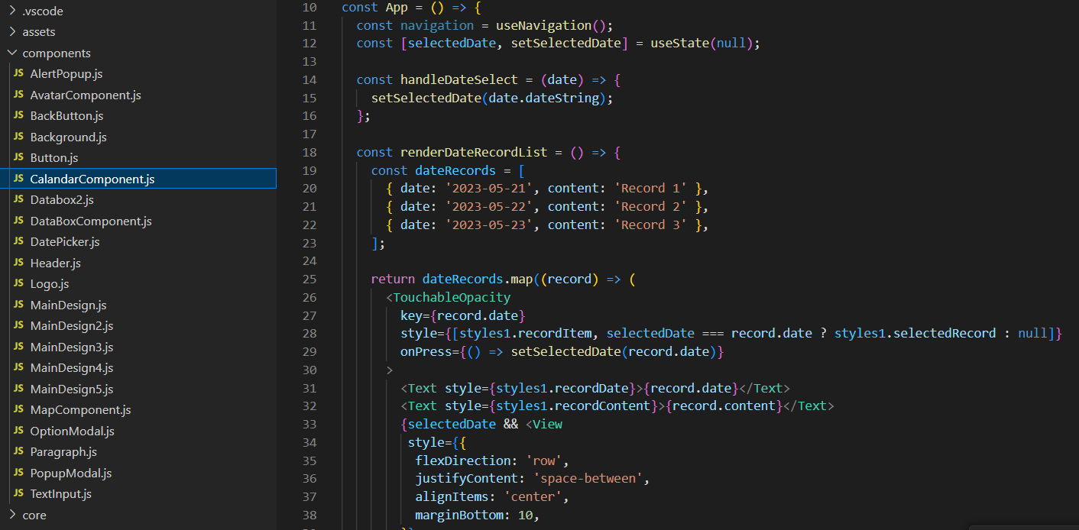

Code Snippets
IT20034740 | Jayasinghe J.M.S.U. |2023-081

Slide 64
Tasks to be completed
Train models and improve accuracy
Implementing text summarization
Integrate and test the whole system together
Commercialize the application
IT20034740 | Jayasinghe J.M.S.U. |2023-081

Slide 65

Gitlab Repository
IT20034740 | Jayasinghe J.M.S.U. |2023-081

Slide 66
Gantt Chart
IT20034740 | Jayasinghe J.M.S.U. |2023-081

Slide 67
Work Breakdown Structure
Improving the cognitive independence and wellbeing of dementia patients by motivating them to maintain a digital audio diary.
Feasibility Study
Requirement Analysis
Design
Implementation
Testing
Documentation
Identifying the problem
Gather Requirements
System Design
Implementation of voice recognition and speech to text conversion
Unit Testing
Project Charter
Design s Solution
Analize Requirements
Interface Design
Implementation of generated text based mechanisms
Integration Testing
Project Proposal
Literature Review
Well Optimized
User Acceptance Testing
Research Paper
System Testing
Final Report
IT20034740 | Jayasinghe J.M.S.U. |TMP-23-081

Slide 68
References
[1] Personal Journal Keeping and Linguistic Complexity Predict Late-Life Dementia Risk: The Cache County Journal Pilot Study, Jessica J. Weyerman, Cassidy Rose, and Maria C. Norton
[2] Modifying the Diary Interview Method to Research the Lives of People With Dementia, Ruth Bartlett, originally published online 3 October 2012
[3] An independent evaluation of ‘Dementia Diaries’. Woodall, J and Surr, C and Kinsella, K and Bunyan, A (2016)
[4] Speech to text and text to speech recognition systems-Areview
Ayushi Trivedi,Navya Pant, Pinal Shah,Simran Sonik and Supriya Agrawal
DepartmentofComputerScience, NMIMS University,Mumbai,India.
[5] Speech to text conversion and summarization for effective
understanding and documentation Vinnarasu A., Deepa V. Jose
Department of Computer Science, CHRIST (Deemed to be University), India
IT20034740 | Jayasinghe J.M.S.U. |2023-081

Slide 69

Hiththatiyage D.K
IT20162696
BSc (Hons) in Information Technology (Specialization in Software Engineering)
Improving cognitive independence of dementia patients by directing them to the appropriate music therapy sessions while analyzing their emotional state
IT20162696 | Hiththatiyage D.K |TMP-23-081

Slide 70
Research Gap
Real-time EEG-based emotion recognition for music therapy [2]
Alive Inside: Developing mobile apps for the cognitively impaired[3]
Emotion Based Music Player[1]
IT20162696 | Hiththatiyage D.K |TMP-23-081

Slide 71
Research Problem
Inability to control emotional changes
Emotional responses frequently vary
Caregivers lack the expertise to assist patients
Third prty not being available all thetime
Existing tools lacks the accessibility for dementia patients
Music recommendations are ineffective in elevating mood
IT20162696 | Hiththatiyage D.K |TMP-23-081

Slide 72
Detecting the Face using a face Detection Model
Research Objectives
Collecting facial expression data with the help of an emotion extraction module
Improving cognitive independence of dementia patients by directing them to the appropriate music therapy sessions while analyzing their emotional state
Choosing the appropriate therapeutic music session using an emotion-audio integration module
IT20162696 | Hiththatiyage D.K. |TMP-23-081

Slide 73
Methodology
IT20162696 | Hiththatiyage D.K |TMP-23-081

Slide 74

System Diagram
IT20162696 | Hiththatiyage D.K. |TMP-23-081

Slide 75
Tools and technologies
React Native
GitLab
MongoDB
Firebase
Python

Slide 76
Techniques and Algorithms
OpenCV (Open Source Computer Vision Library) in conjunction with Keras
OpenCV is a powerful library that provides a wide range of functions and algorithms for image and video processing,
OpenCV can be used to load and preprocess images before feeding them into the Keras model for further preprocessing.
A neural network used in image recognition and extraction [5]
Automatically detects the important features without any human supervision [5]
Convolution Neural Network (CNN)
IT20162696 | Hiththatiyage D.K |TMP-23-081

Slide 77
Evidences for the Completion
IT20162696 | Hiththatiyage D.K |TMP-23-081

Slide 78

High Fidelity Prototype
IT20162696 | Hiththatiyage D.K |TMP-23-081

Slide 79


Mobile Application UI
Activity Selection Page for the Patient
Landing Page
IT20162696 | Hiththatiyage D.K |TMP-23-081

Slide 80


Mobile Application UI
Face Capturing using Front Camera
IT20162696 | Hiththatiyage D.K |TMP-23-081

Slide 81


Mobile Application UI
Music Player
Alert Box
IT20162696 | Hiththatiyage D.K |TMP-23-081

Slide 82




Code Snippets
IT20162696 | Hiththatiyage D.K |TMP-23-081

Slide 83
Tasks to be completed
Train the ML model and improve the accuracy.
Introduce music libraries to the patient
Integrate and test the whole system together
Commercialize the application
IT20162696 | Hiththatiyage D.K |TMP-23-081

Slide 84
Gantt Chart
IT20162696 | Hiththatiyage D.K |TMP-23-081

Slide 85
Work Breakdown Structure
Improving cognitive independence of dementia patients by directing them to the appropriate music therapy sessions while analyzing their emotional state
Feasibility Study
Requirement Analysis
Design
Implementation
Testing
Documentation
Identifying the problem
Gather Requirements
System Design
Implement a Face detection Model
Unit Testing
Project Charter
Design s Solution
Analize Requirements
Interface Design
Implement a Emotion Extraction Model
Integration Testing
Project Proposal
Literature Review
Well Optimized
User Acceptance Testing
Research Paper
System Testing
Final Report
IT20162696 | Hiththatiyage D.K |TMP-23-081

Slide 86
References
[1] Emotion Based Music Player,
Hafeez Kabani1, Sharik Khan2, Omar Khan3, Shabana Tadvi4
[2] Sourina, Olga & Liu, Yisi & Nguyen, Minh Khoa. (2011). Real-time EEG-based emotion recognition for music therapy. Journal on Multimodal User Interfaces. 5. 10.1007/s12193-011-0080-6.
[3] Alive Inside: Developing Mobile Apps for the Cognitively Impaired Martine Nezerwa, Robert Wright, Stefan Howansky, Jake Terranova
[4] Music Recommendation Based on Face Emotion Recognition Madhuri Athavle1 , Deepali Mudale2 , Upasana Shrivastav3 , Megha Gupta4
[5] A. Dertat, “Applied Deep Learning - Part 4: Convolutional neural networks,” Towards Data Science, 08-Nov-2017. [Online]. Available: https://towardsdatascience.com/applied-deep-learning-part-4-convolutional-neural-networks-584bc134c1e2. [Accessed: 31-Jan-2022].
IT20162696 | Hiththatiyage D.K |TMP-23-081

Slide 87
Spread the word around Dementia Individuals
Obtain regulatory approval
COMMERCIALIZATION
Sponsor content creators with the same disability
Provide ongoing support

Slide 88

Budget for overall system

Slide 89

Demo Time

Slide 90
THANK YOU!

